Slide 1
MOTracker®️ project
Business Problem Analysis and Approaches

Slide 2

What is Multiple Object Tracking ?
As the name suggests, multiple object tracking consists of keeping track of objects in a video as they move around.
A formal description would be for each frame in a video, localize and identify all objects of interest, so that the identities are consistent throughout the video.

Slide 3
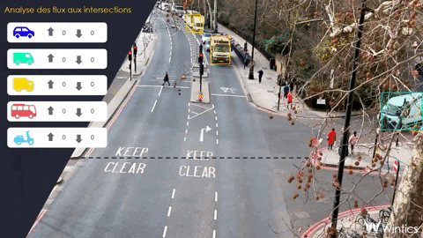

Slide 4
What is Multiple Object Tracking ?
In other words, a good model must accurately detect objects in each frame and provide a consistent labelling of them.
Challenges arise when objects are partially or completely occluded, or temporarily leave the field of view, since ideally the objects should keep their former IDs when reappearing.
Furthermore, objects whose paths intersect might confuse the model and cause it to erroneously switch their IDs.

Slide 5

What is Multiple Object Tracking ?
Different scenarios exist that allow for different types of models.
An important distinction is that of online versus offline models.

Slide 6
What is Multiple Object Tracking ?
An online model receives video input on a frame-by-frame basis and must give an output for each frame.
This means that, in addition to the current frame, only information from past frames can be used.
Offline models, on the other hand, have access to the entire video, which means that information from both past and future frames can be used.

Slide 7
What is Multiple Object Tracking ?
The task can then be viewed as an optimization problem, where the goal is to find a set of paths that minimize some global loss function.
This has been solved using linear programming and k-shortest path optimization methods .
Since offline trackers have access to more information, one can expect better performance from these models.
It should be noted, however, that real-time usage requires online models, as future frames are obviously unavailable.

Slide 8
What is Multiple Object Tracking ?
Models can be further categorized into single class and multiple class models.
In the former, all tracked objects are of the same class, e.g., person, while in the latter, multiple classes are present, e.g., pedestrian, bicycle and car.
On one hand, having multiple classes introduces the problem of classifying each object. On the other hand, this could act as a distinguishing feature when the paths of objects of separate classes intersect.

Slide 9
The MOT Methodology
Modern multiple object tracking (MOT) systems usually follow the tracking-by-detection paradigm.
This common methodology is to split the tracking into two phases: prediction of object location and matching of detections and predictions.
That is, for each new frame, the complete tracking model does the following:
(1) Detect objects of interest,
(2) Predict new locations of objects from previous frames,
(3) Associate objects between frames by similarity of detected and predicted locations.
Although some methods diverge from this approach slightly, e.g., by matching objects in multiple steps based on confidence values , or keeping multiple hypotheses active , most works differ simply doing these three steps in distinct ways.

Slide 10
How is tracking different from detection?
There is a tight relationship between tracking and detection.
Detection consists in locating one or several objects in each image whereas the goal of tracking is to locate these objects throughout a whole video, keeping track of which object is which along the video frames.
In order to track an object, we first need to provide the image of the said object to the tracking algorithm, and this is either done by a detection algorithm (Detection-based trackers) or manually (Detection-free trackers).

Slide 11
Detection
The goal in object detection is, as the name suggests, to detect all objects of a certain class in an image.
Alternatively, multiple classes can exist, in which case it is also required to correctly classify each object.
The input to an object detector is an image, and the output is a list of bounding boxes, with labels in the case of multiple classes.
A bounding box is usually represented by the pixel coordinates of the top-left and bottom-right corner of the bounding box, or the coordinates of the center as well as the width and height of the box.
Furthermore, most object detectors provide a confidence value with each box, indicating how trustworthy the detection is.

Slide 12
Prediction
A multitude of approaches have been suggested for how to predict new locations of tracked objects.
Some examples include computing the optical flow to determine the new position , or using recurrent neural networks , Kalman filters or particle filters to model the velocity of objects, and with this predict the position in future frames.

Slide 13
Association
The association task consists of determining what detection corresponds to what object, based on the predictions from the previous step, or alternatively if a detection represents a new object.
Problems arise when tracked objects leave the scene or are otherwise not detected, new objects enter the scene, the detector produces false positives – i.e., “detecting” an object that does not exist – or when the predicted positions differ greatly from reality.

Slide 14
The project's core concept
MOTracker®️ project consists of building a Computer Vision (CV) engine that takes input, which can be a live stream, or a pre-recorded video stream, from a platform, performs MOT, and outputs the appropriate meta data about it.
The input can be from a fixed camera or from a moving one and can be in real-time or pre-recorded.

Slide 15

The project's core concept
The outputted result would be categorized into 3 sections:
Raw Output (class of the detected object, list of objects, accuracy of prediction, timestamps of prediction, location, etc.)
Mining Output (Speed, acceleration, path, Status, etc.)
Prediction Output (Predicted path, status, speed, etc.)

Slide 16
Type of Outputs
This criterion classifies MOT methods into deterministic ones and probabilistic ones, depending on the randomness of output.
The output of deterministic tracking is constant when running the methods multiple times.
While output results are different in different running trials of probabilistic tracking methods.

Slide 17

Deterministic Outputs
First, we will discuss Speed. It is one of the most important metrics to extract while applying the MOT algorithms.
Speed is.... relative. And we can only give an estimation of it given the data we have. Speed estimation of the vehicles for example using frame count is computed as: S = d × f / n.
Here f is the frame rate of the camera in frames/second, d is the length of the surveillance zone in meters, and n is the frame count of the vehicle.

Slide 18
Deterministic Outputs
Now, we will talk about acceleration, which is highly correlated with the speed variable.
By finding the Centroid of the object we can easily find the acceleration by finding the distance between the pixels of the Centroid of an object in the successive Image sequences. Then for finding the object moving direction image trajectory data is used.
We approximate the acceleration by differencing the velocity field between frames. By reference to the same starting position, the time axis is reversed when estimating the previous velocity: a(t) = v(t+1) - (- v(t))

Slide 19

Deterministic Outputs
Now, we will address the Path Output variable.
Each moving object has a well-determined trajectory that falls under time and location snapshots over the whole process of its movement.
Tracking paths is performed in a sequence of video frames.
Its processing mainly consists of two main stages: separation of objects from background in each frame and connecting those objects in successive frames to trace them

Slide 20
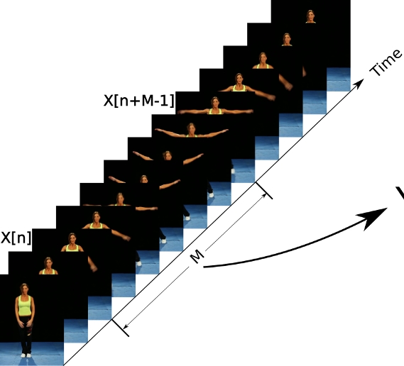
Building Blocks of a Detection by Tracking Methodology
The tracking method is divided into 2 main steps:
The 1st step is to apply object detection into each video frame. The aim is to detect the number and the nature of each object present in the frame.

Slide 21
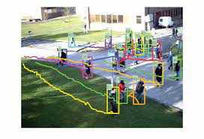
The 2nd step is to associate each detection to tracks. This is done to keep track of each object’s identity from one frame to the next.

Slide 22

This method comes with its own limitations and challenges nevertheless!

Slide 23

Challenges & Limitations
MOT is a challenging problem: ID switches are hard to avoid especially in crowded videos, and the nature as well as the number of objects in each frame is unknown, so MOT algorithms strongly rely on detection algorithms, which are themselves not perfect.

Slide 24
Challenges & Limitations
Finding the appropriate datasets is also a challenge while working on an MOT problem.
Sources are especially limited if we are going to pick a video-based approach to train our model ( which will be the case in this type of project).

Slide 25
Challenges & Limitations
Evaluating MOT itself causes some problems too.
Firstly, MOT algorithms depend on the detector, and the community does not always agree on the protocol to follow: should we evaluate the tracker with the same detector for all, or should we evaluate the whole system (detector + tracker) together?
Lastly, although some performance measures such as MOTA are commonly used, some researchers still do not adhere to this metric.

Slide 26
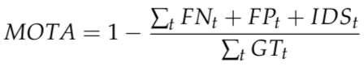
Challenges & Limitations
The MOTA (Multiple Object Tracking Accuracy) is the most used summary metric for MOT. It is defined as follows:
FN_t is the number of false negatives (missed targets), FP_t the number of false positives (ghost trajectories), IDS_t the number of identity switches at time t

Slide 27
Challenges & Limitations
For object classification and detection tasks, huge progress have been made, and algorithms achieve performance comparable to that of humans. But while it is easy for a human to track an object, today’s trackers are still far from that goal, which requires to capture the spatial and temporal relation between targets.
To give a clearer idea, in the summary metric of MOT, MOTA, the best algorithms do not go beyond 0.6 (the best possible score is 1.0). One should go into details to understand this metric, but it still means that there is room for improvement compared to the ideal case.

Slide 28

Real-time MOT
There is no clear definition in multiple object tracking on what inference speed is required for a model to be said to work in real-time.
Instead, it is said that a model is real-time if it can give output as fast as, or faster than, the rate of which input is given.
That is, a tracker is real-time if it can analyze 60 s of video in less than one minute – otherwise, it is not.
However, the video is not continuous, but is captured at a certain framerate, and the frames are input to the tracker with a constant interval.

Slide 29
Real-time MOT
This means that a 60 s video captured at 30 FPS results in 1800 (60 × 30) images to be processed by the tracker but decreasing the frame-rate to 10 FPS gives only 600 (60 × 10) images.
Since online methods are required to give an output before the next input is provided, the delay of the system (i.e., the time it takes to get an output after providing an input) is directly related to the speed in which images are analyzed.

Slide 30
Real-time MOT
For example, if a tracker can analyze images in 30 FPS, then the delay is 1/30 s.
Of course, additional delay can arise from the time it takes to send the output to the user, though this overhead can be expected to be constant, and is not a part of the tracker.

Slide 31
Challenges & Limitations: Real-Time tracking
The success of a video tracking algorithm depends upon the quality of its response to a high frame- rate input video.
The higher the frame-rate is, more difficult it becomes for an algorithm to produce accurate results.
Real-time object detection models should be able to sense the environment, parse the scene and finally react accordingly.
The model should be able to identify what all types of objects are present in the scene.
Once the type of objects have been identified, the model should locate the position of these objects by defining a bounding box around each object.

Slide 32
Challenges & Limitations: Real-Time tracking
We can potentially face multiple challenges when we are working on a real-time problem:
How do we deal with variations? The variations might be of difference in the shape of objects, brightness level, etc.
Deploying object detection models. This generally takes A LOT of memory and computation power, especially on machines we use daily
Finally, we must also keep a balance between detection performance and real-time requirements.
Generally, if the real-time requirements are met, we see a drop in performance and vice versa. So, balancing both these aspects is also a challenge

Slide 33
Challenges & Limitations: Real-Time tracking
When determining the speed of the tracker, it is common to not include the time it takes to detect objects.
We propose that one way of running a method in real-time is to not look at every frame but skip frames to make the video have the same frame-rate as the tracking method.
However, we believe that this will lead to decreased performance.

Slide 34
Conclusion
MOT is a challenging yet interesting problem, and the field is still growing.
Most of the algorithms are benchmarked on the MOT challenge.
However, the existing datasets are still application-dependent (human tracking for the MOT challenge), and there remains some debate on some points of the evaluation methods.
Additionally, it is hard to pick a class of methods which really stands out, and existing algorithms (even top performers) still have room for improvement.
Many complex algorithms have been tried and have been outperformed by simpler methods such as exploiting the detector (Tracktor, IOU), and extending with other techniques…
Inspired by the progress of Single Object Tracking (SOT), some researchers have also successfully tried to incorporate Single Object Trackers into MOT.

Slide 35

Thank You For Your Attention!
I hope that together, we will lead this project to success!

